Slide 1
Compare and Contrast
Understanding the Elements of Art using works from the Polk Museum of Art Collection.

Slide 2
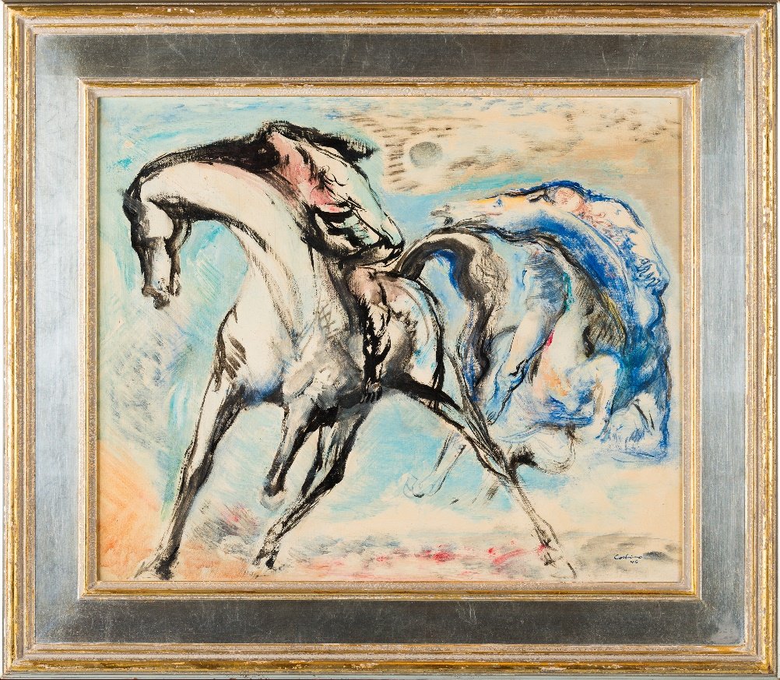
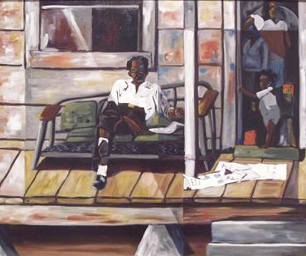
Line
Jon Corbino, The Race, 1946. Oil on Canvas
John W. Butler, The Front Porch, 1999. Oil on Canvas
Notes:
Definition: a mark that spans a distance between two points; marks or outlines that help to define shapes in works of art
BIG IDEA: How are lines used in works of art?
Discussion idea 1: Irregular (Organic) vs. Regular (Geometric) lines- how does this relate to the mood in a work of art?
Discussion idea 2: How do the lines used in these works effect how realistic the works appear?
Teacher Fast Facts:
Jon Corbino b. 1905, d. 1964
Style of art called Romantic Realism

Slide 3
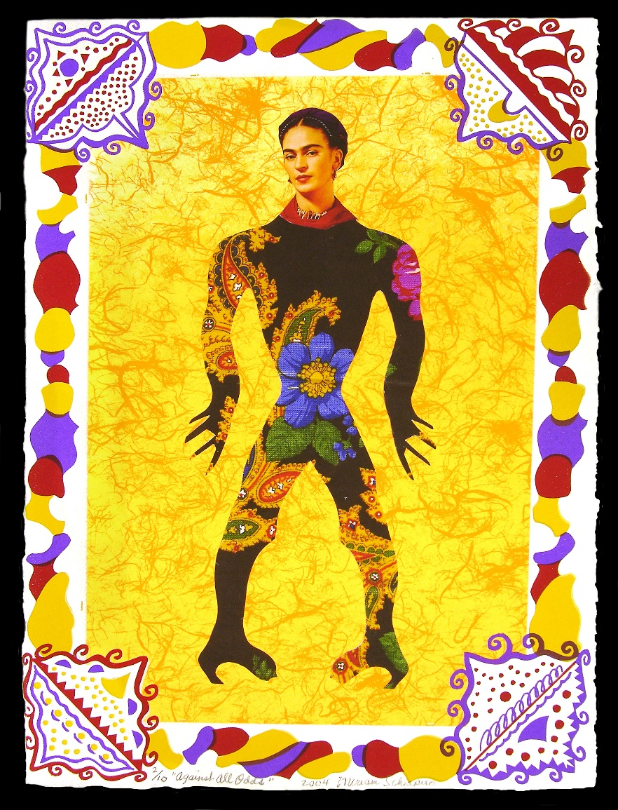
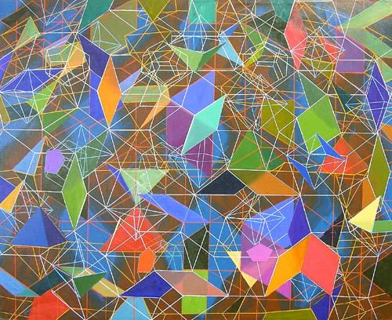
Shape
Tony Robbin, 39453, 2008. Oil on canvas
Miriam Schapiro, Paper Doll Series: Against All Odds, 2004. Screen Print with Mixed Media
Notes:
Definition: connected lines that enclose space
BIG IDEA: Different kinds of shapes can have different roles in works of art. (e.g. focal point, pattern, etc.)
Discussion idea 1: Organic (Nature-derived) vs. Geometric (Mathematical) shapes- How are they different? Where do you see them used in each work?
Discussion idea 2: Why would an artist create an artwork that only contained shapes? (As on the right, in contrast to the left)
Teacher Fast Facts:
Miriam Schapiro- feminist artist most prominent in 60s and 70s, d. 2015
The woman portrayed in this work is famous female artist Frida Khalo
Tony Robbin, b. 1943 (still alive)
Often combines 2D and 3D art together to visualize 4 dimensions within art
Tony Robbin created a computer program that lets you visualize 4D geometry (his work is based on the idea of 4 dimensions)

Slide 4
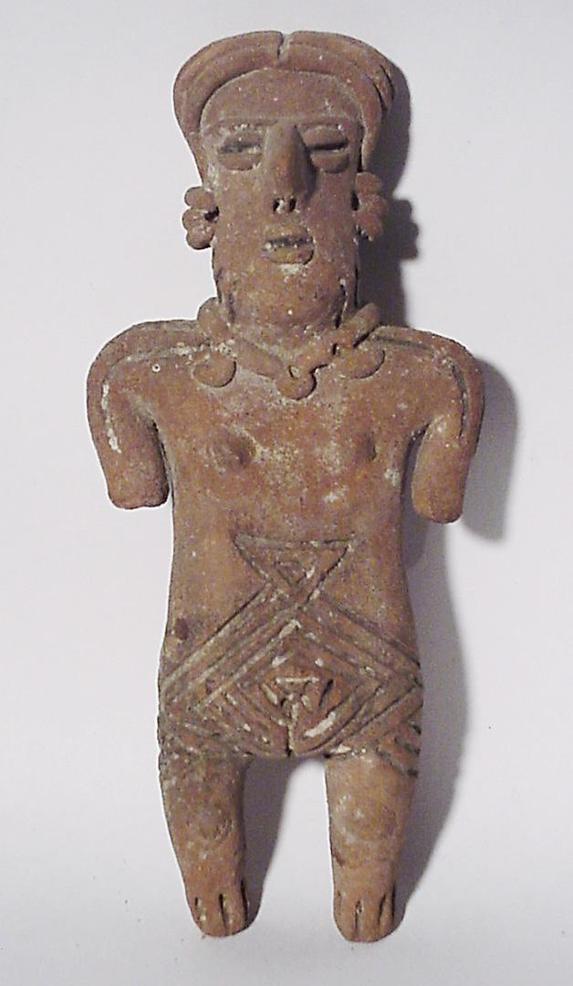
Form
Scott Causey, I'm Late, I'm Late, I'm Late, 2001. Ceramic
Unknown, Ancient American Figurine
Notes:
Definition: a shape that has become three-dimensional
BIG IDEA: Form and shape can be described in similar ways. Form is 3D.
Discussion idea 1: How can a 3D object show movement? (As on the left) Why would some works not show movement?
Discussion idea 2: Why do you think that color is used differently in these two works? (This is a great time to show that the elements of art all work together)
Teacher Fast Facts:
Scott Causey (contemporary) went to college at Ringling College of Art and Design in Sarasota
Most of his works in ceramic are brightly colored animals
Ancient American cultures used ceramic for a large portion of their art
These kinds of works are dug up from the ground by archaeologists, lots of times we don’t know a ton of information about them

Slide 5
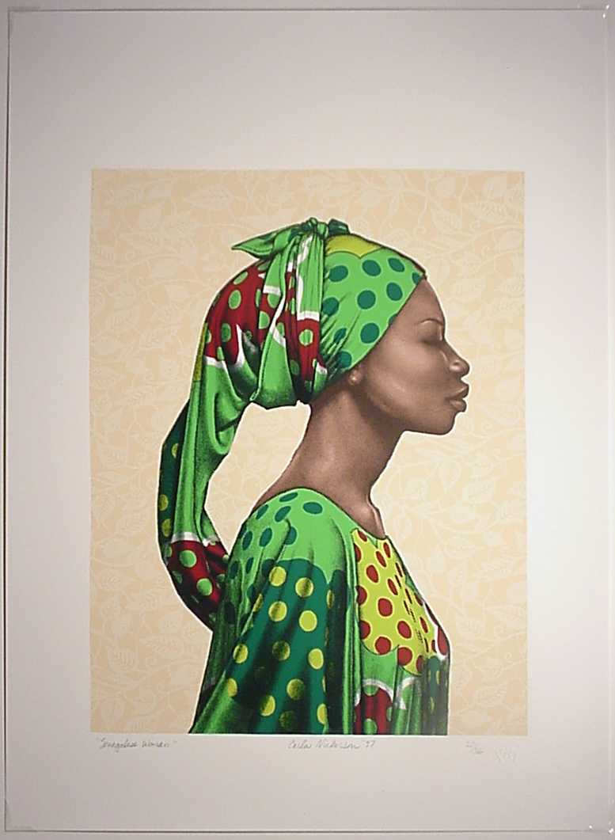
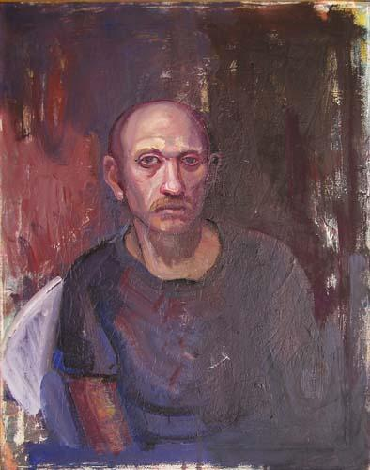
Color
Carla Nickerson, Senegalese Woman, 1997. Screen Print
Stephen Schatz, Billy, 2001. Oil on canvas
Notes:
Definition: produced when light strikes an object and is reflected back to the eye
BIG IDEA: Color is used very purposefully by artists. Each color used represents a choice.
Discussion idea 1: Which artwork has more realistic colors? What makes you say that?
Discussion idea 2: What ideas or emotions are represented by the colors in these two works?
Teacher Fast Facts:
Carla Nickerson is an African-American artist that is inspired by her African heritage and culture
Themes in her art deal with the idea of being a “warrior”
She also creates performance art
Stephen Schatz currently lives in New Port Richey, Florida. Teaches at St. Petersburg College
Wants to depict multiple emotions at once, has people sit for him when he creates their portraits instead of using reference photographs

Slide 6
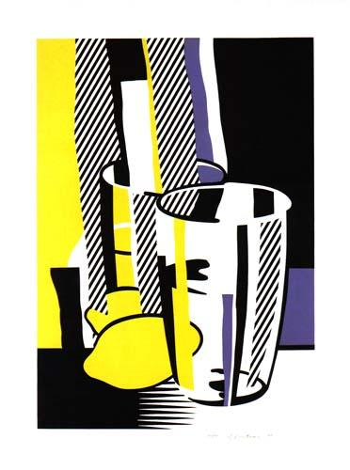
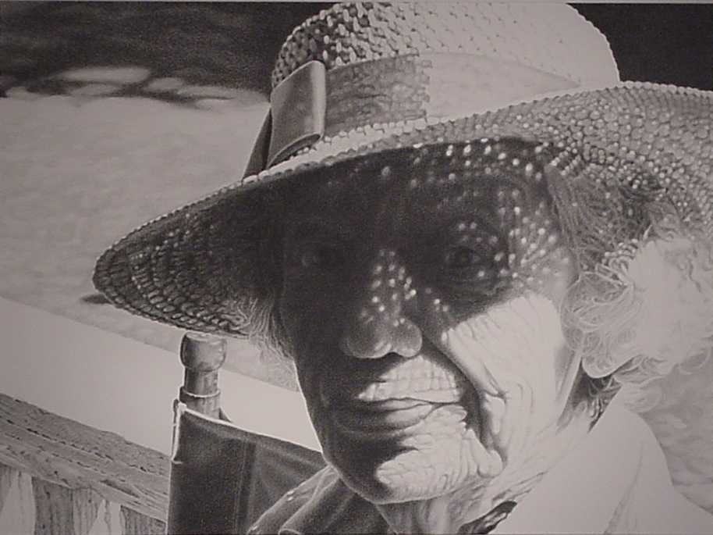
Value
Louise Cherwak, The Survivor, 1999.
Graphite on paper
Roy Lichtenstein, Before the Mirror, 1975. Offset Lithograph
Notes:
Definition: lightness or darkness of a color
BIG IDEA: Value is used to express 3D Form in 2 dimensional works of art
Discussion idea 1: How do these artists use tints and shades differently? (Sharp contrast in light and dark vs. subtle transition between tones)
Discussion idea 2: What if the artist didn’t show light and dark values in these works? How would this change what you know about the object or person being portrayed? (e.g. wouldn’t know that the glass was 3D, wouldn’t know The Survivor was portraying a sunny day)
Teacher Fast Facts:
Roy Lichtenstein (b.1923, d.1997) was a Pop Artist along with Andy Warhol-they were known for using recognizable images as their subject matter
Lithography is a printmaking process where you can only print 1 color at a time, so this work had to be printed 3 times to be completed
Louise Cherwak (d. 2008) lived in Florida for all of her life
Her drawings are often mistaken for photographs, but she likes to take the time to make drawings that are detailed and emotional
Uses a range of 14 different graphite pencils to try to replicate the tones/feelings of colors we would see in real life

Slide 7
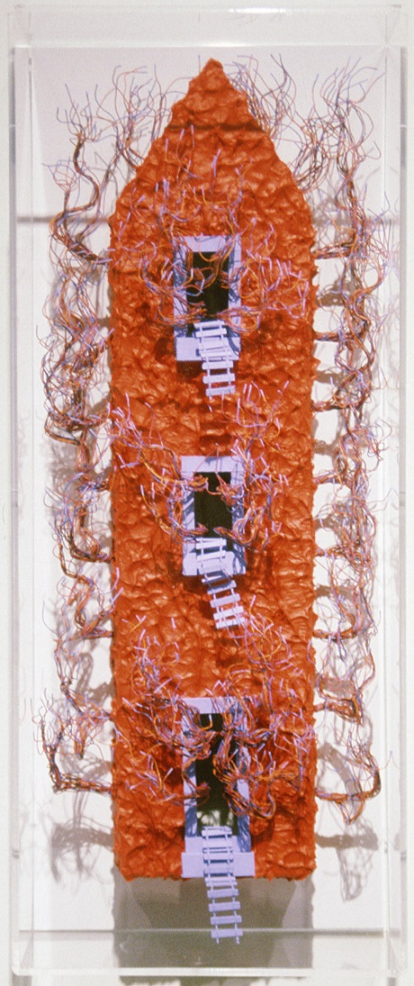
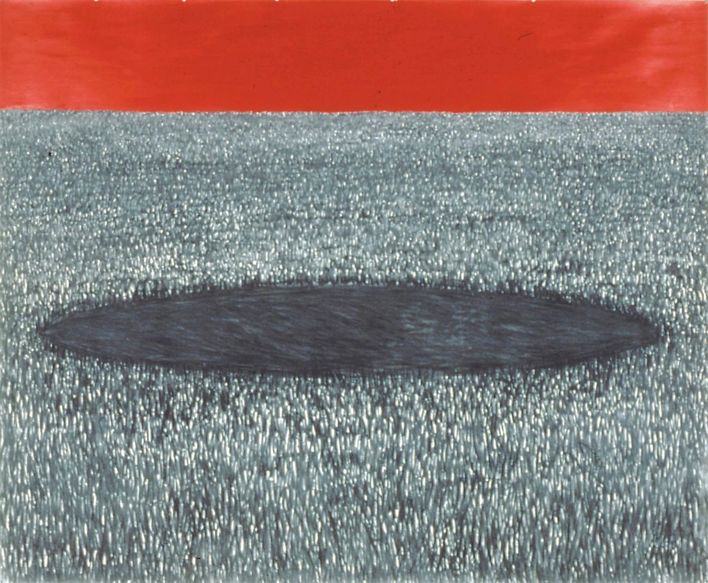
Texture
Maggie Davis, Trouble, Charcoal and acrylic on paper. 1990
Larry Rhoads, Hot House, 1997, Mixed media
Notes:
Definition: how the surface of a material looks and “feels”
BIG IDEA: Texture can be tactile (real) or visual (conveyed when no texture present)
Discussion idea 1: How did the artists create texture in their work? (painted it vs. combined textured items together) What is a benefit of creating texture in each way?
Discussion idea 2: What are some challenges an artist might face if they are making a work with tactile texture? (Trouble finding the right texture, difficult to hang on a wall, etc.)
Teacher Fast Facts:
Maggie Davis (contemporary) thinks abstract paintings can have their own narrative and convey emotions.
Wants the elements of her work (texture, color, shape) to interact in a relational way, much like people do.

Slide 8
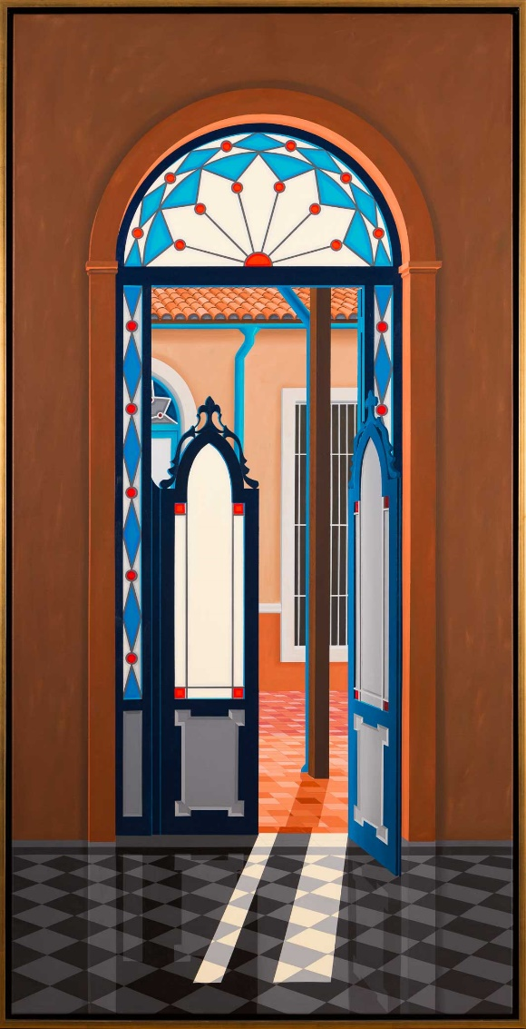
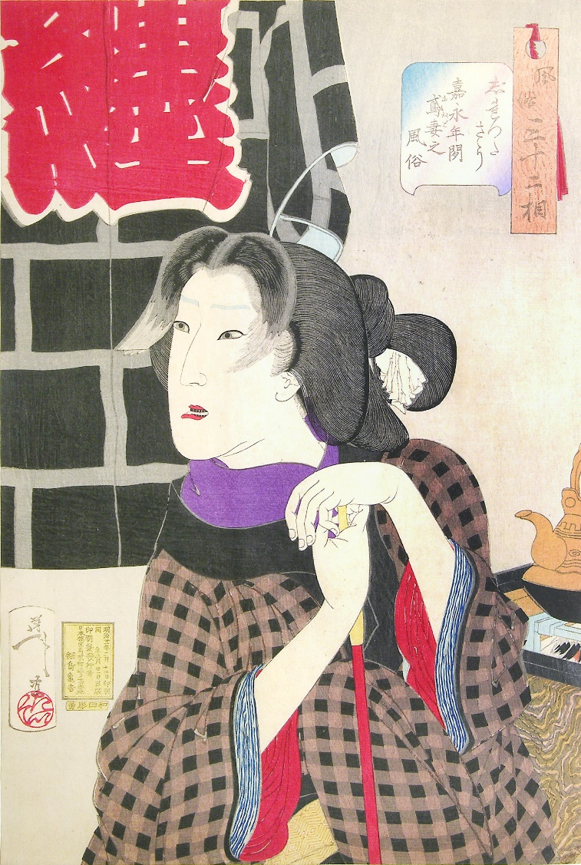
Space
Tsukioka Yoshitoshi, Expectant: The appearance of a fireman's wife of the Kaei era, 1848-1854. Woodblock print
Humberto Calzada, The Philosophy of Privacy, 2010. Acrylic on canvas
Notes:
Definition: the creation of depth in a work of art.
Three areas of a composition:
Foreground - the part of an artwork that seems to be the closest to you
Middle ground - the part of an artwork that is between the background and the foreground
Background - the part of an artwork that seems to be the farthest from you
BIG IDEA: Some artists choose to create a realistic sense of space in their artworks, while others do not
Discussion idea 1: How can you tell what is in the foreground and background of each work? (e.g. overlapping as opposed to changes in size, etc.)
Discussion idea 2: Where do you see checkerboard (or repeating square) patterns used in these two works? How does the artist use this pattern to show perspective? (e.g. pattern changes direction on woman’s clothes to show 3D effect, checkerboard in Philosophy is diagonal to show depth)
Teacher Fast Facts:
The artist Yoshitoshi is recognized as a Japanese master in woodblock printing, in which wood is carved to make a stamp and each color is printed one at a time
Expectant is one of a series called Thirty Two Aspects of Customs and Manners. All 32 works are related in theme and story
Humberto Calzada was born in Havana, Cuba. His artworks are inspired by the architecture there
His works are supposed to feel dreamlike, and he was influenced by surrealism.

