Slide 1
Let’s be a Curator!
1
Developing a Title Wall using works from
the Polk Museum of Art Collection.

Slide 2
What is a Curator?
a person in charge of selecting content for a museum exhibition.
Curators choose which works of art should be exhibited and decide how they should be seen. This includes creating a Title Wall for the exhibition!
Notes:
QUESTION
What is a Curator?
ANSWER
A curator is a person in charge of selecting content for a museum exhibition.
Curators choose which works of art should be exhibited and decide how they should be seen. This includes creating a Title Wall for the exhibition!

Slide 3
What is a Title Wall?
a wall usually located at the front of a gallery that displays the
exhibition title describing what the audience will see.
Notes:
QUESTION
What is a title wall?
ANSWER
A title wall is a wall usually located at the front of a gallery that displays the exhibition title describing what the audience will see.

Slide 4
Notes:
Let’s put that into practice.
QUESTION
What is the title of this exhibition, and what type of works do you think you might see? ANSWER
Title: Global Art of the 1970s
This exhibition highlights works from around the globe that were produced in the 1970s. Types of artwork range from paintings to sculpture to textiles.

Slide 5
Notes:
What about this one?
QUESTION
What is the title of this exhibition, and what type of works do you think you might see?
ANSWER Title: What’s the Story?
Featuring more than forty works from the Museum’s permanent collection, this show places each viewer into the role of narrator. Viewers use their own imaginations to look beyond the canvas and envision the unwritten stories in works of art with open-ended narratives.

Slide 6
Notes:
Now that you are familiar with using the title wall…
QUESTION
How do you think curators select content for an exhibition? ANSWER By finding shared similarities and/or common meaning within a collection of works. These selections might come from a museum’s existing collection, personal collections, or even from foundations who are responsible for the safe preservation and display of a particular collection.
The similarities between works can be based on an singular artist, a moment in time, or based purely on visual elements they may all share.
This exhibition is titled, The Art of the Highwaymen. For a bit of context, this collection of artwork featured 26 individual artists who became known as the “Highwaymen”. This name was adopted because these artists created and sold their artwork on the side of our Florida highways.

Slide 7
Let’s try titling our own exhibition as a class!

Slide 8
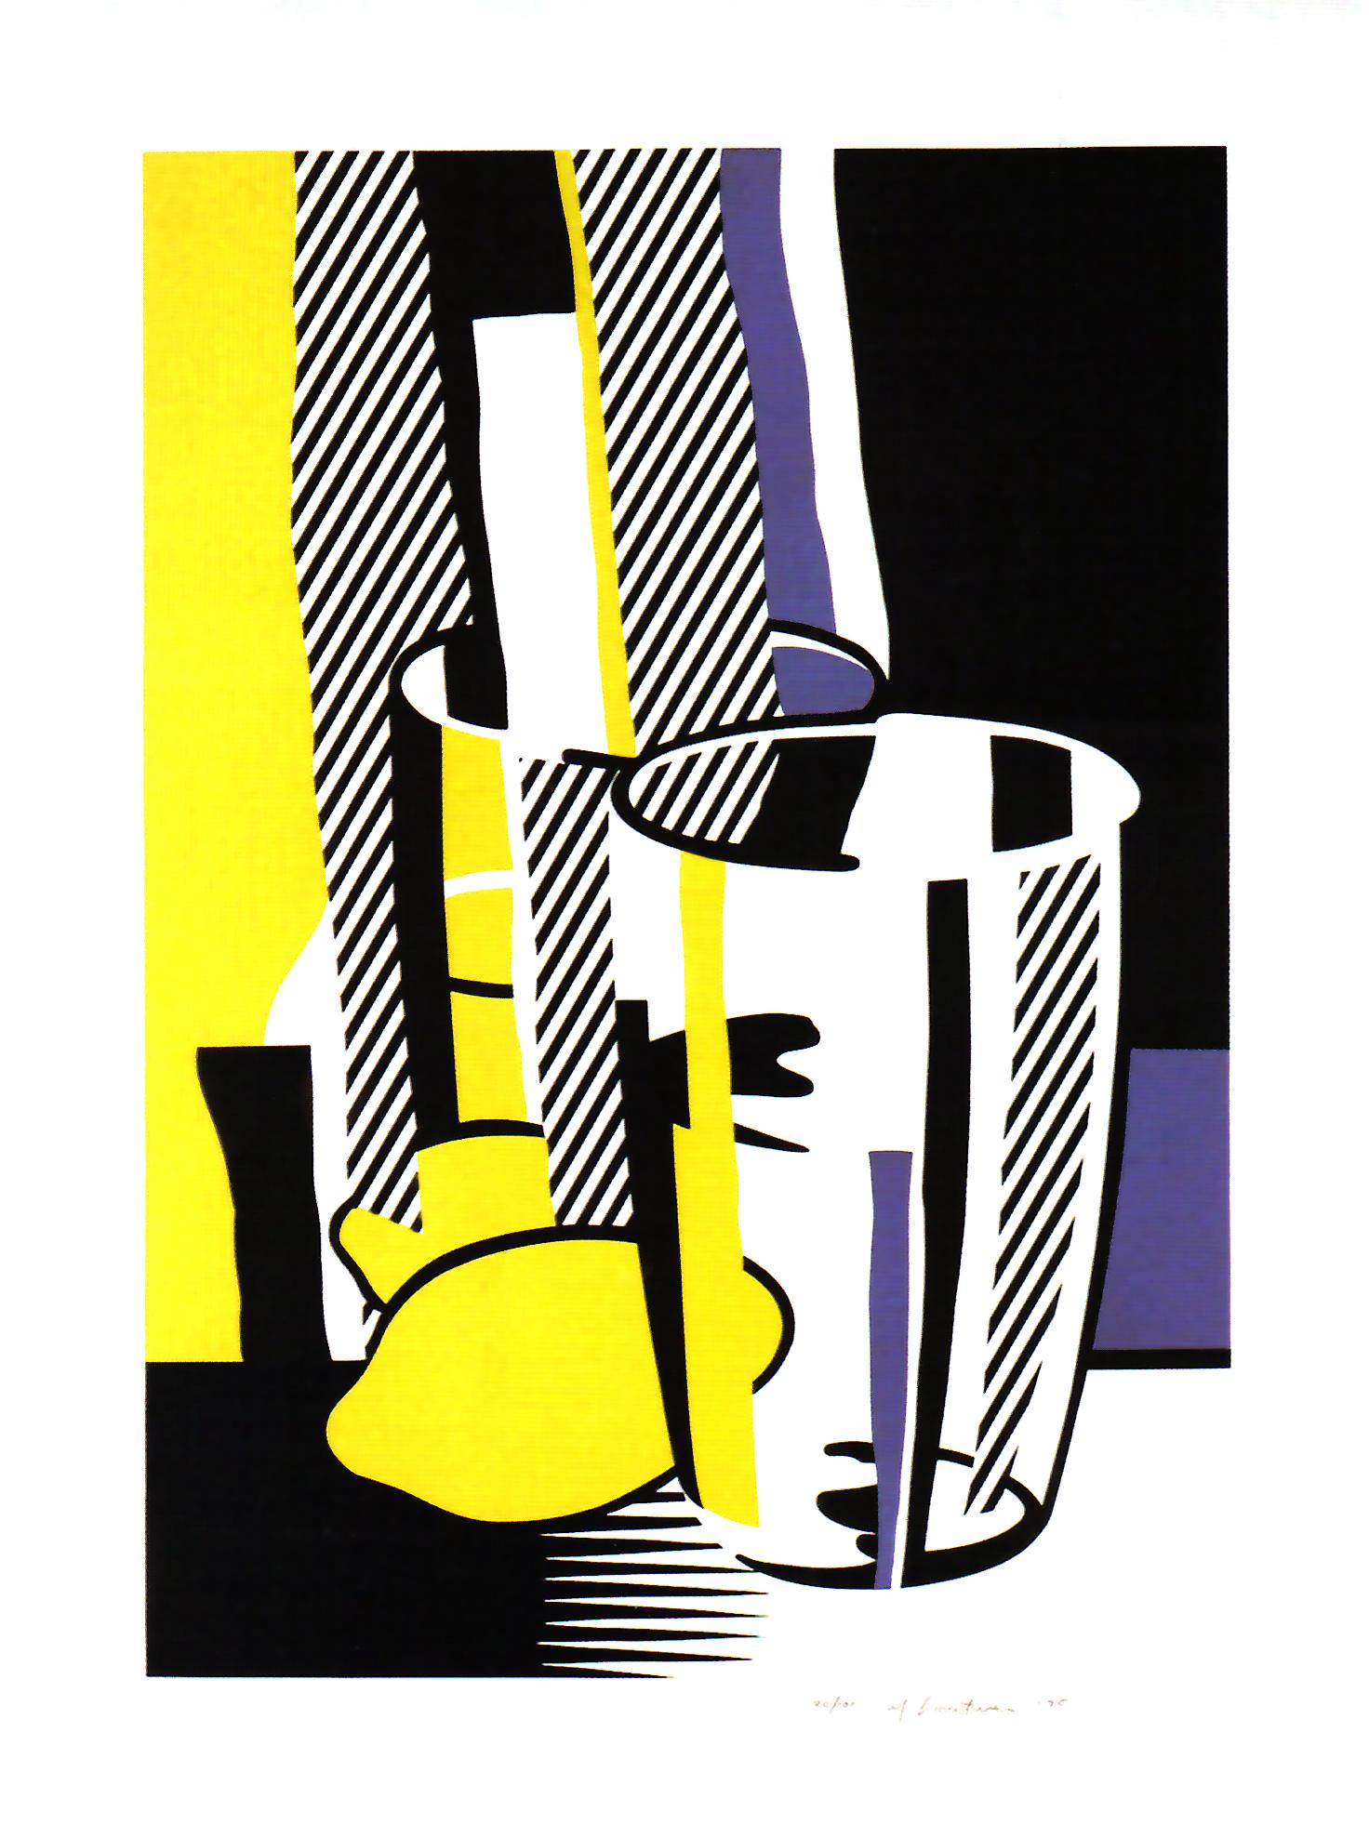
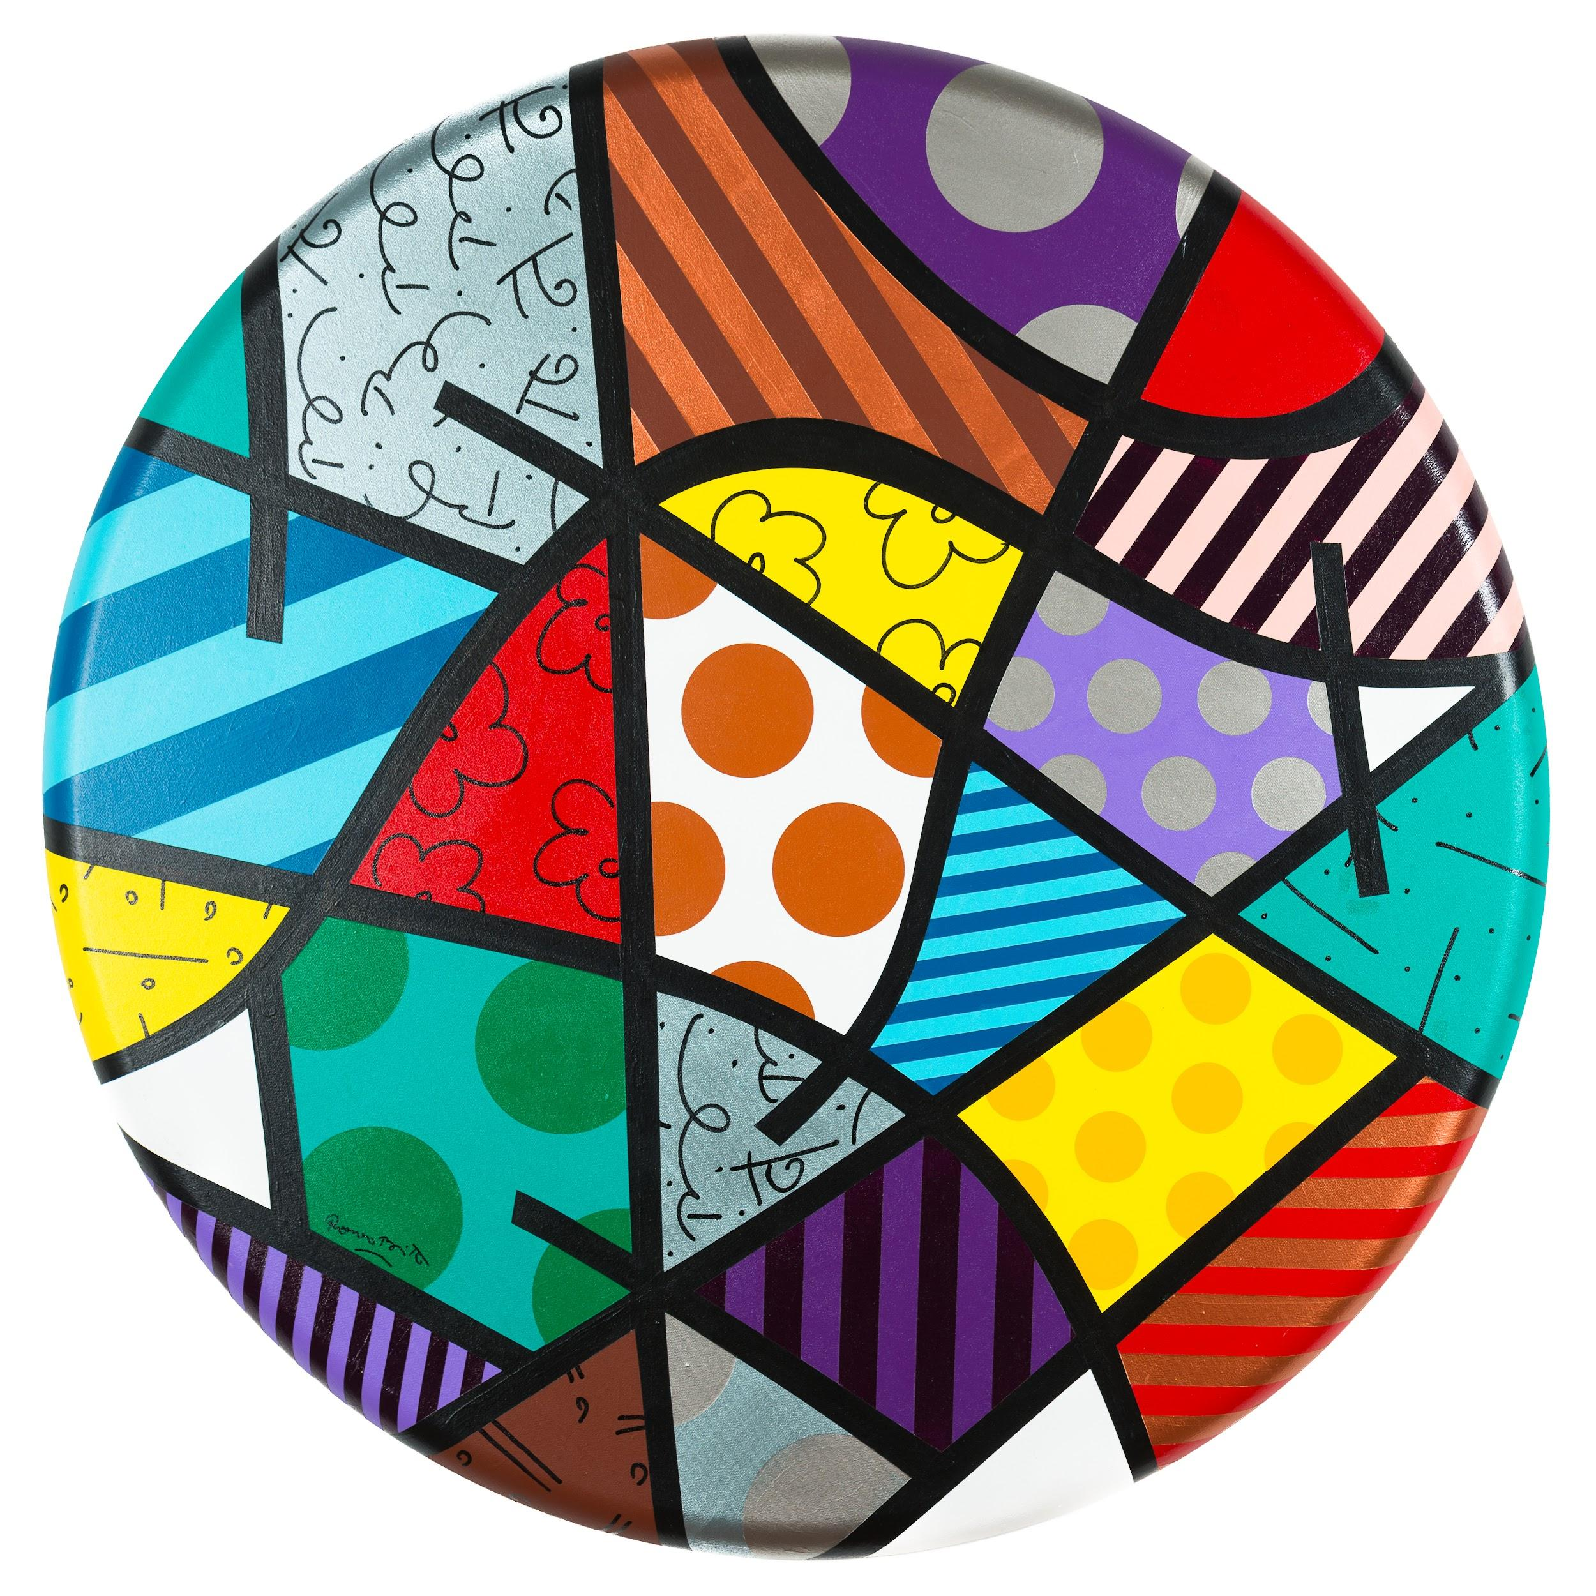
Notes:
CLASS PRACTICE
What might you title this exhibition? PROMPTS Are there any visual similarities between the pieces?
Any common elements? (Elements of Art) Color? Shape? Pattern?
DESCRIPTION When you come up with a title, please support it by using descriptive words.

Slide 9
Now, let’s try it on our own!
(Use Title Wall worksheet)

Slide 10
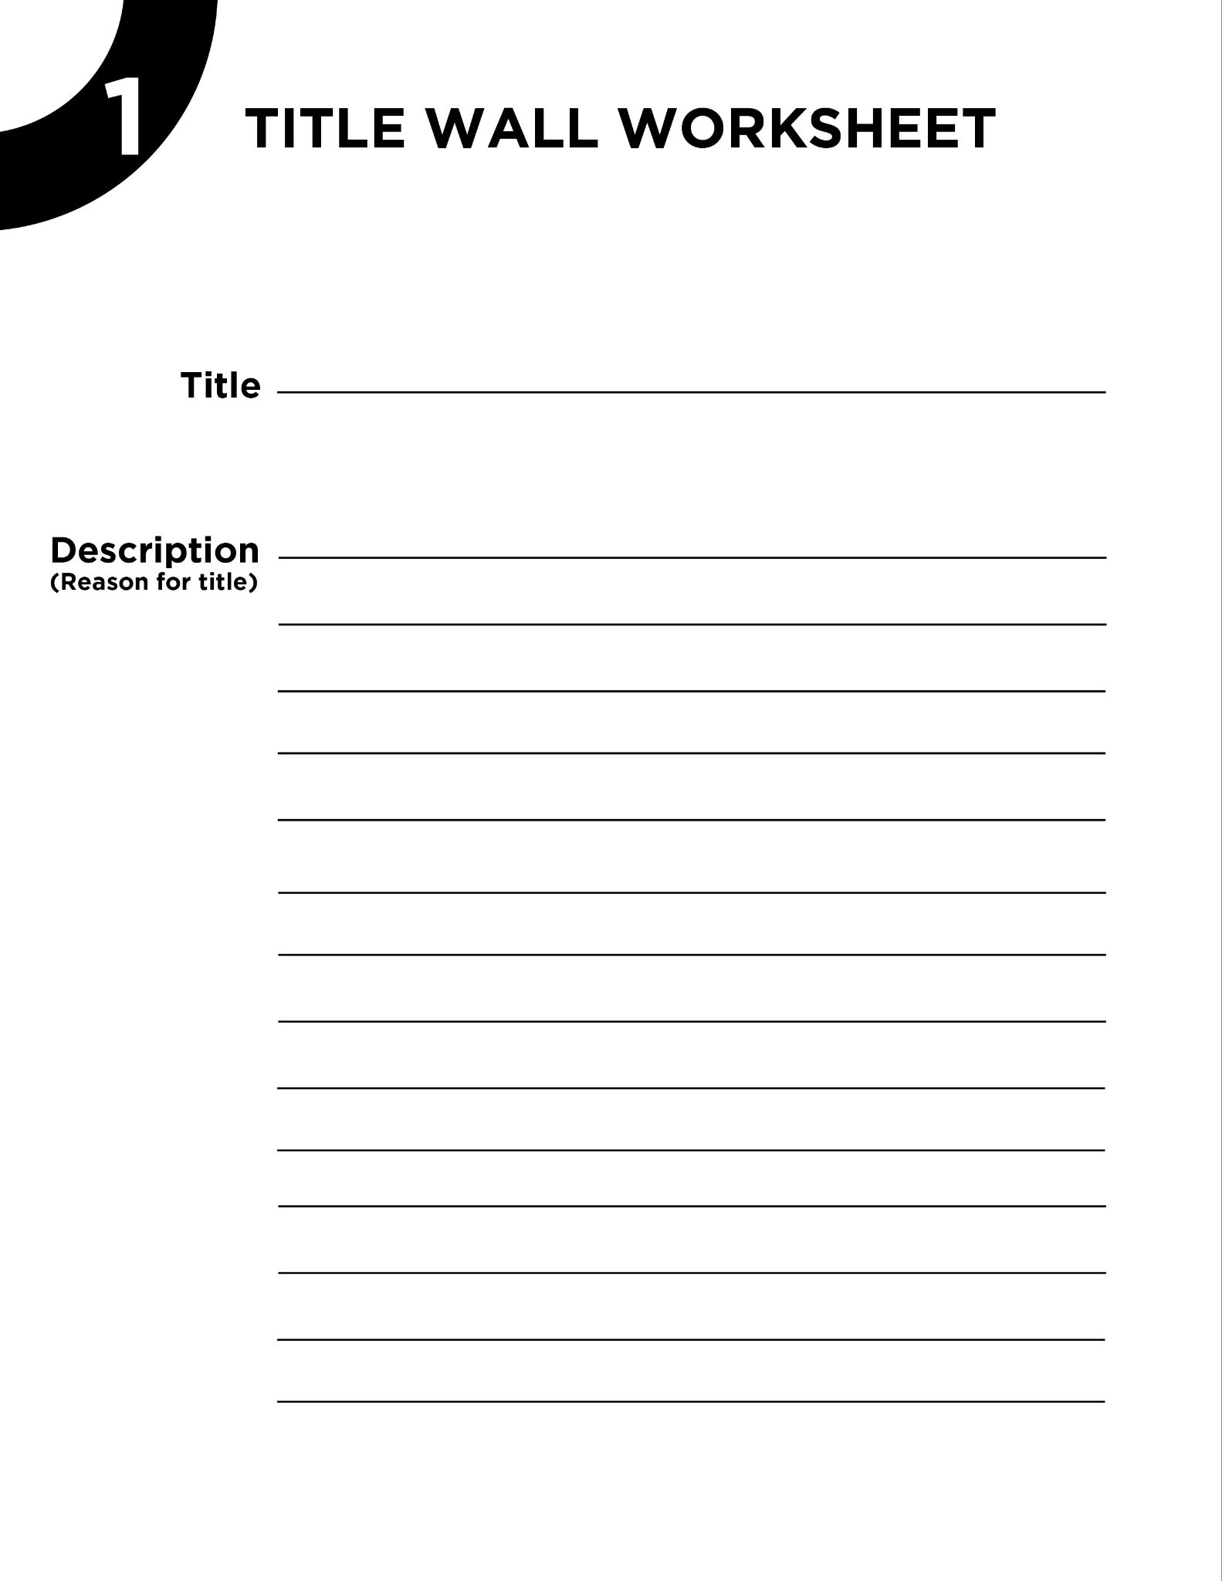
Grab a worksheet and a pencil!

Slide 11
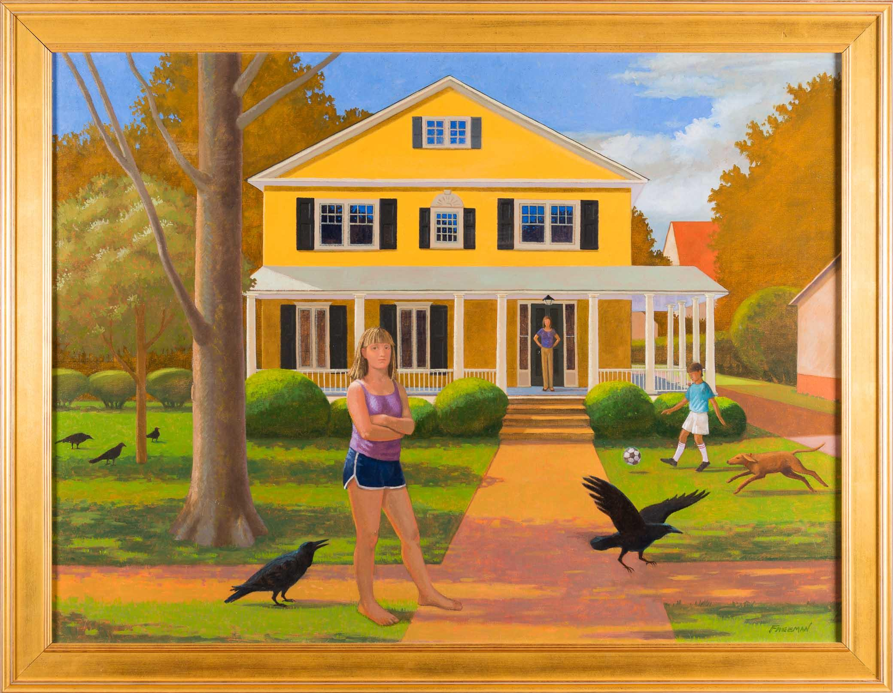
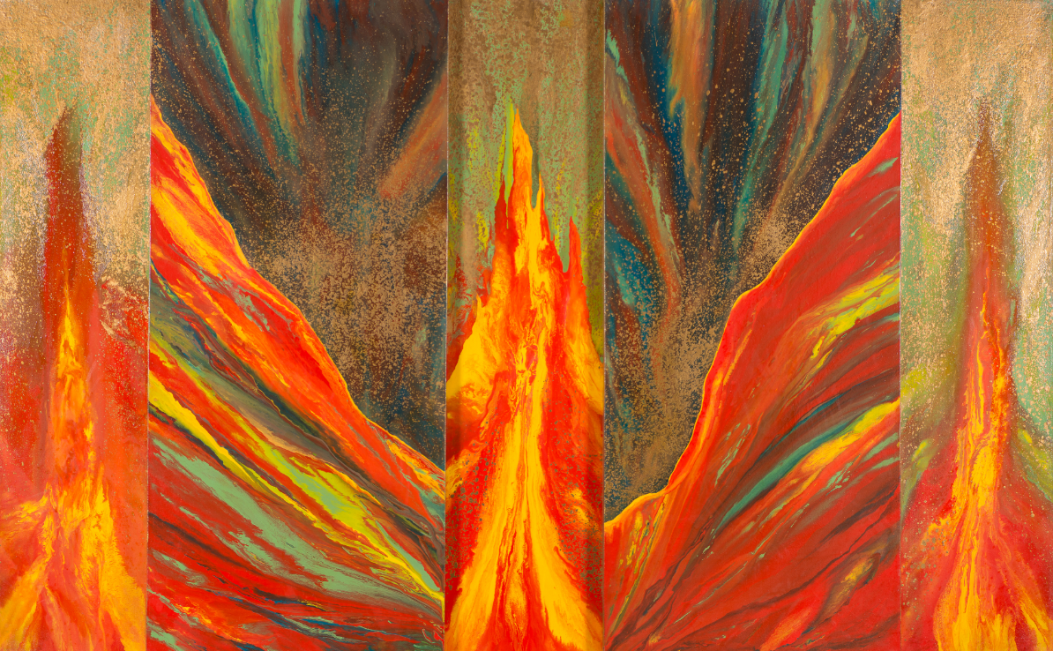
Notes:
USE WITH TITLE WALL WORKSHEET
What would you title this exhibition? PROMPTS Are there any visual similarities between the pieces?
Any common elements? (Elements of Art) Color? Shape? Pattern?
DESCRIPTION When you come up with a title, please support it by using descriptive words.

Slide 12
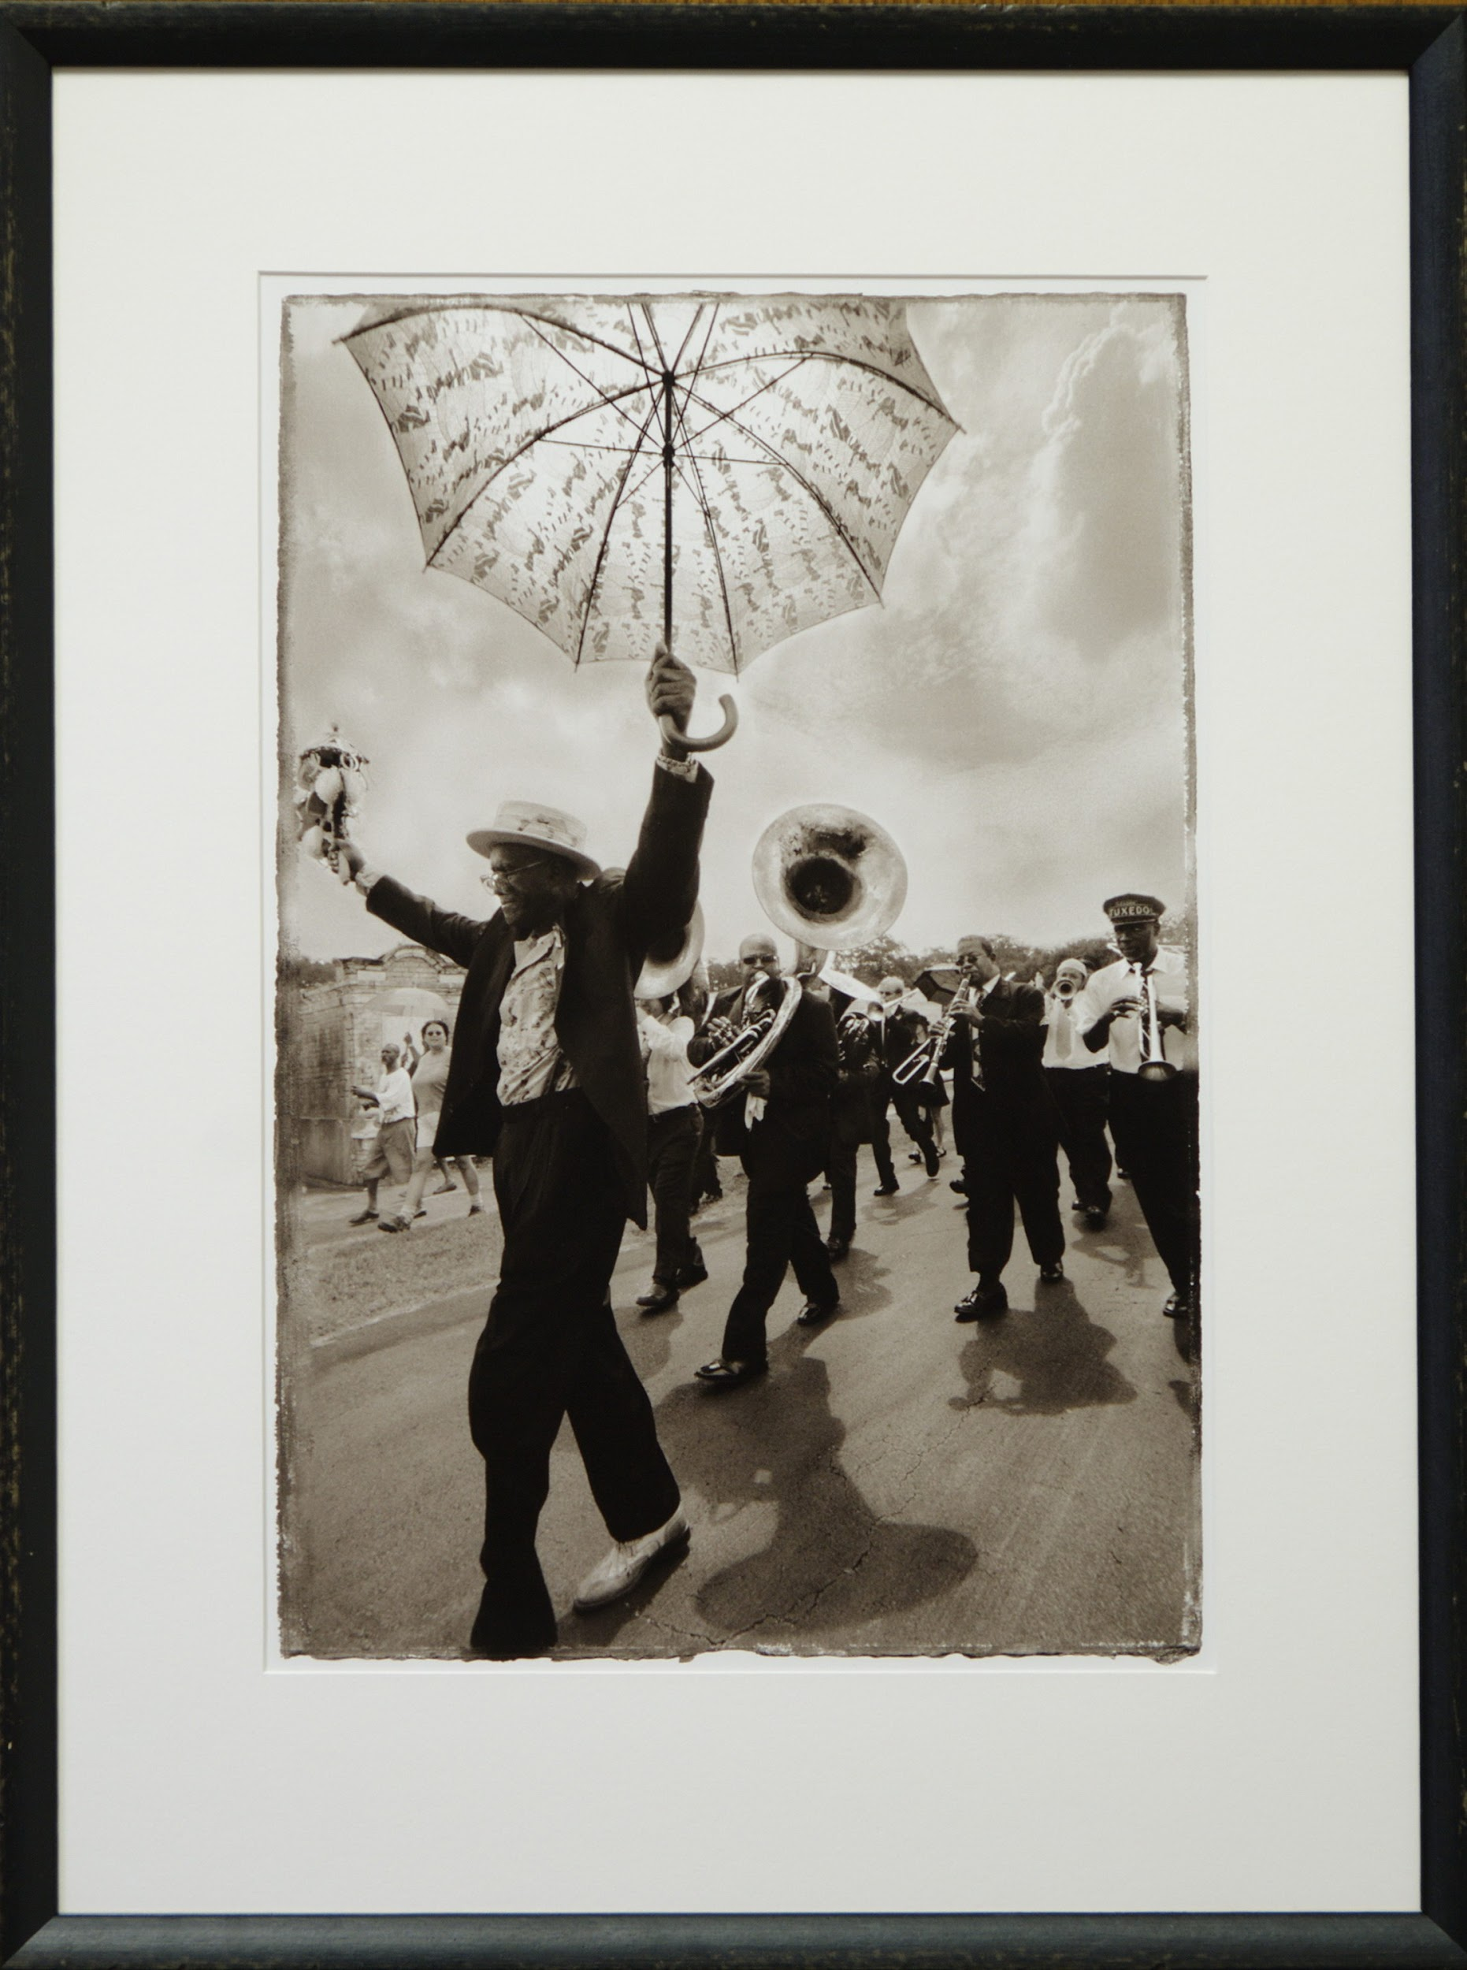
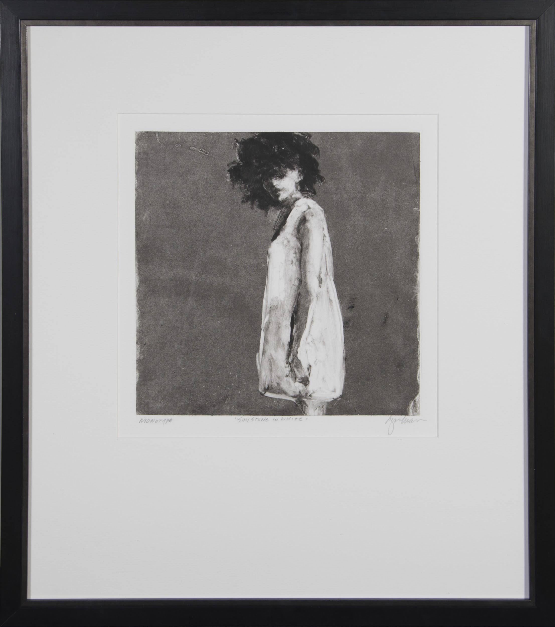
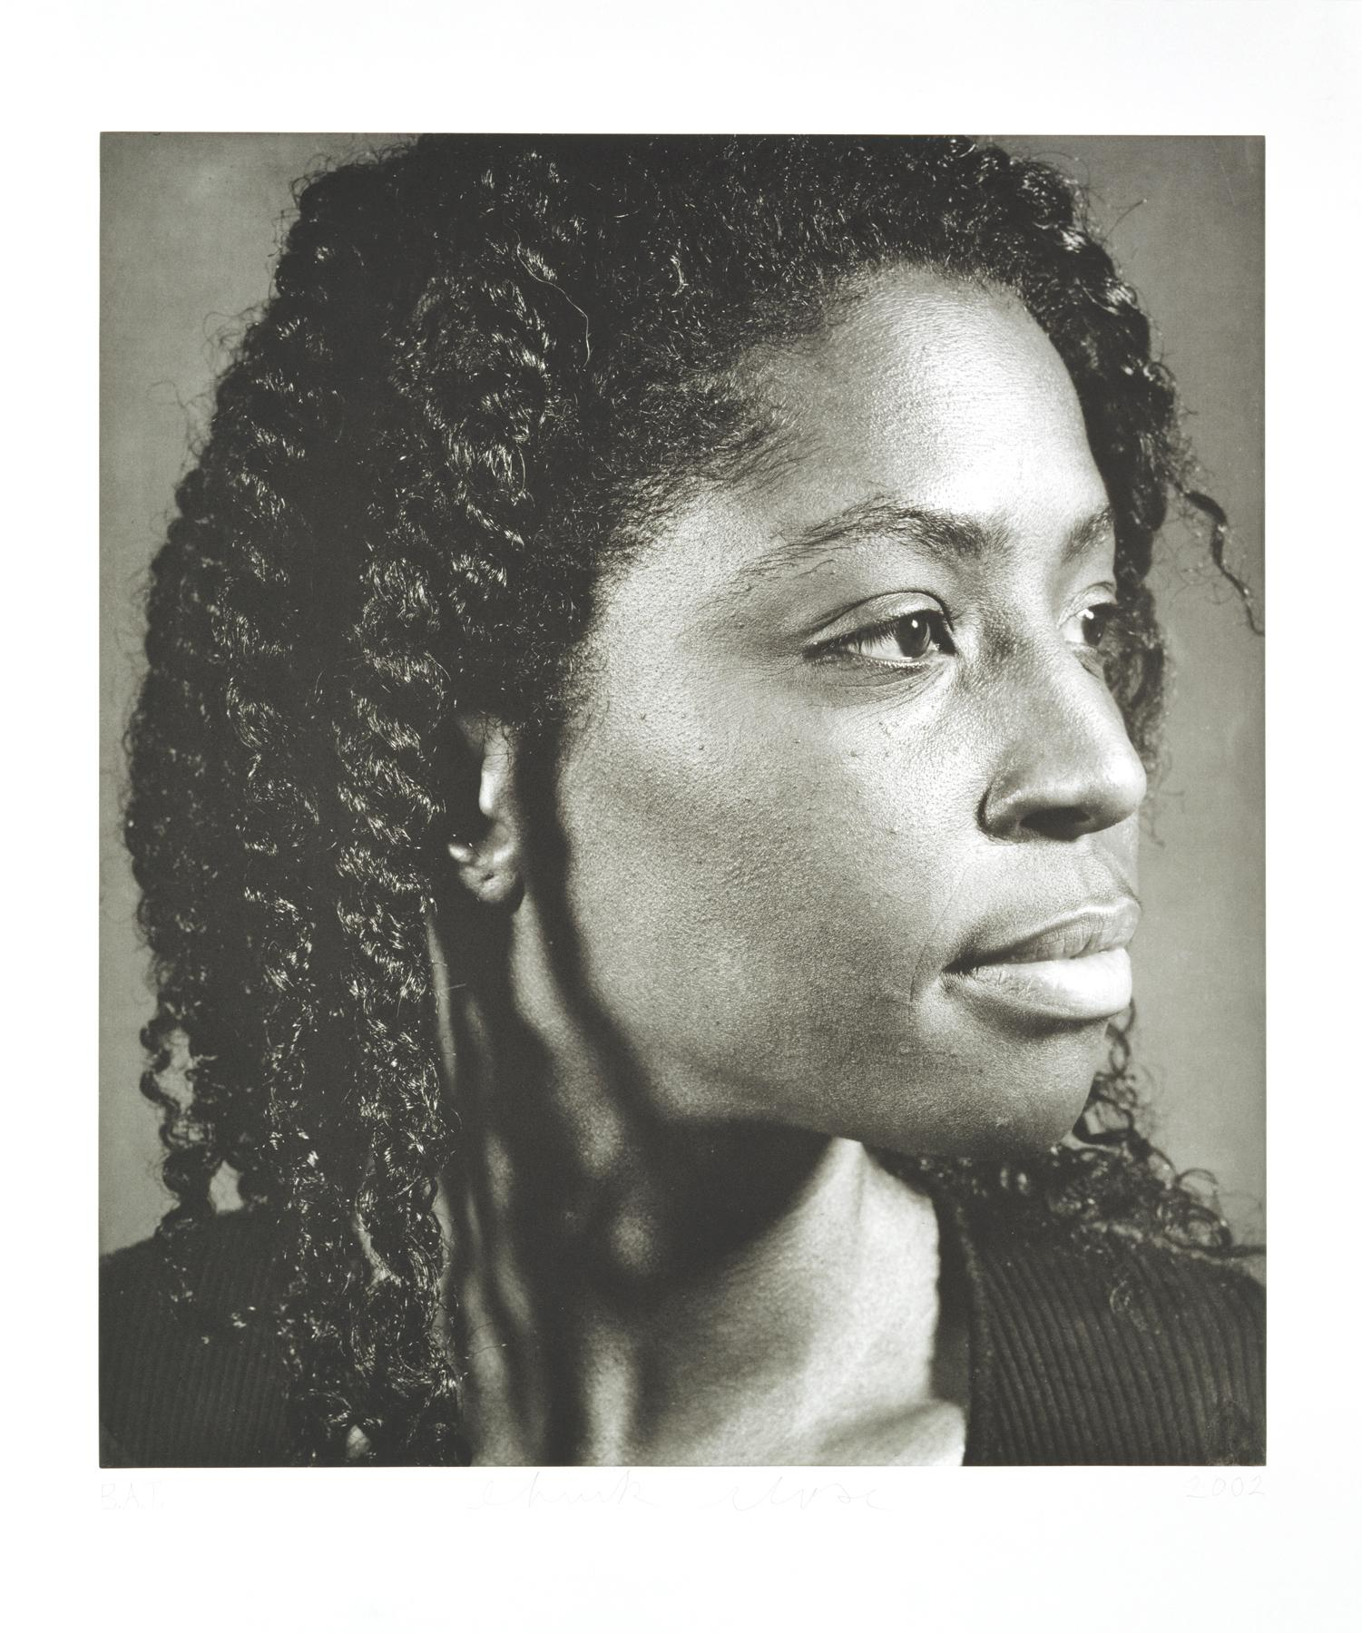
Notes:
USE WITH TITLE WALL WORKSHEET
What would you title this exhibition? PROMPTS Are there any visual similarities between the pieces?
Any common elements? (Elements of Art) Color? Shape? Pattern?
DESCRIPTION When you come up with a title, please support it by using descriptive words.

Slide 13
CONGRATULATIONS!
You are now a Title Wall expert.

